Slide 1
UNDERSTANDING GLOBAL BUSINESS ENVIRONMENT
Dr. Kwangsoo Kim
Konkuk University

Slide 2
AGENDA
Importance of Understanding GBE
Concept of Globalization
Trend of Globalization
Impact of Globalization
Implications and Conclusions

Slide 3
Importance of Understanding
Global Business Environment

Slide 4
ENVIRONMENT – ORGANIZATION RELATIONSHIPS
Influencing the environment
Environment
Organization
Influencing the organization

Slide 5
ENVIRONMENT – ORGANIZATION RELATIONSHIPS (continued)
General
Environment
Industry
Environment
Economic
Demographic
Global
Competitors
Technologies
Social
Customers
Firm
Suppliers
Global
Creditors
Labor union
Stock holders
Political/Legal
Technological

Slide 6
MODERN MANAGEMENT FRAMEWORK
STRATEGY
Vision/Mission
Objectives/Goals
Strategies
GLOBAL ENVIRONMENT
World/Country/Market
General/Industry
ORGANIZATION
Resources/Capabilit.
Structure
Systems/processes
Culture
Leadership, Staffing
etc.
ECONOMIC
PERFORMANCE

Slide 7
COMPONENTS OF GLOBAL BUSINESS ENVIRONMENT
World/General
Country/General
Trade
FDI
Economic
Market/Industry
Demographic
Competitors
Technologies
Customers
Suppliers
Social
Firm
Legal
Creditors
Labor union
Distributors
Stock holders
Regional
Foreign
Exchange
Political
Technological
International
Institutions
Notes:
국가 차원에서의 글로벌화
- 얼마나 많이 열려있는가
- 얼마나 많이 연결되어 있는가
산업 차원에서의 글로벌화
- 얼마나 많이 연결되어 있는가?
- 생산, 공급, 특허, 인력 등
기업 차원에서의 글로벌화
- 기업 들이 세계화되어 있는가
기능별 차원에서의 글로벌화
- 삼성전자의 R&D가 얼마나 세계화되어 있는가

Slide 8
CONCEPT OF
GLOBALIZATION

Slide 9
DEFINITION
● Interdependence or inter-linkages across national boundaries
● The shift towards an economically, socially, and politically more integrated, interdependent , and interlinked world
- Economic, social, political globalization
● Homogenization of the world
● New international order
Notes:
정의
- 국가/산업/기업 차원에서 연결되어 있는지
- 국가/산업/기업 차원에서 상호의존성이 있는지
- 경제적으로
국가 간의 경계를 초월한 경제적 측면에서의 상호의존성, 상호연결성

Slide 10
SOURCES
● International flows of goods and services
● International flows of capital
● International movement of people/labor
● International flows of ideas, information & knowledge
● International communications
● International diffusion of government policies

Slide 11
UNIT OF ANALYSIS
WORLD
COUNTRY
INDUSTRY
COMPANY

Slide 12
UNIT OF ANALYSIS (continued)
● World Level (General/Macro environment)
◆ Economic interdependence among countries worldwide
◆ Increasing cross-border flows of goods/services, capital,
know-how
● Country Level (General/Macro environment)
◆ Inter-linkages between a country’s economy and the rest of the world.
◆ Exports & imports as a ratio of GDP.
◆ Inward and outward flows of FDI and portfolio investment.
◆ Inward and outward flows of royalty payments.
Notes:
정보
- 무역(FDI)
- 지식정보 이동
- 투자

Slide 13
UNIT OF ANALYSIS (continued)
● Industry Level (Industry/Micro environment)
◆ A company’s competitive position in one country is interdependent
with that in other country.
◆ Cross-border trade within the industry/total worldwide production.
◆ Cross-border investment/total capital invested in the industry.
● Company Level (Company strategy)
◆ A company has expanded its revenue and asset base across
countries & engages in cross-border flows across subsidiaries
◆ International dispersion of sales revenues and asset base
◆ Cross-border trade within the industry/total worldwide production.
◆ Cross-border investment/total capital invested in the industry.

Slide 14
TREND OF
GLOBALIZATION

Slide 15
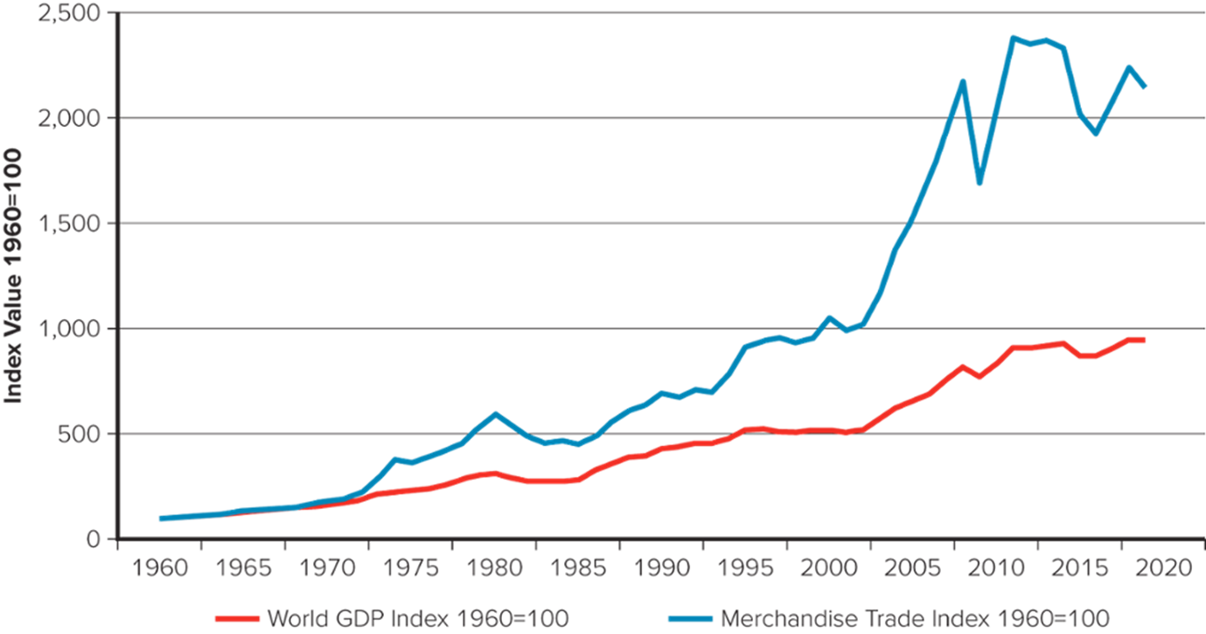
GROWTH OF WORLD MERCHANDISE TRADE RELATIVE TO WORLD GDP
Sources: World Bank, 2020; World Trade Organization, 2020; United Nations, 2020
Notes:
세계화로 인해 자원을 더 효율적으로 활용할 수 있음.
이를 주도하는 국가/산업/기업이 글로벌 룰을 정함으로 인해, 글로벌 자원(인적자원, 물적자원)을 효율적으로 활용하여 이익을 극대화
세계화를 통해 전체 파이가 커지고,
슈퍼파워가 상대적으로 더 많은 파이를 가져간다.
힘이 있으면 세계화를 추진할 수 있다.

Slide 16
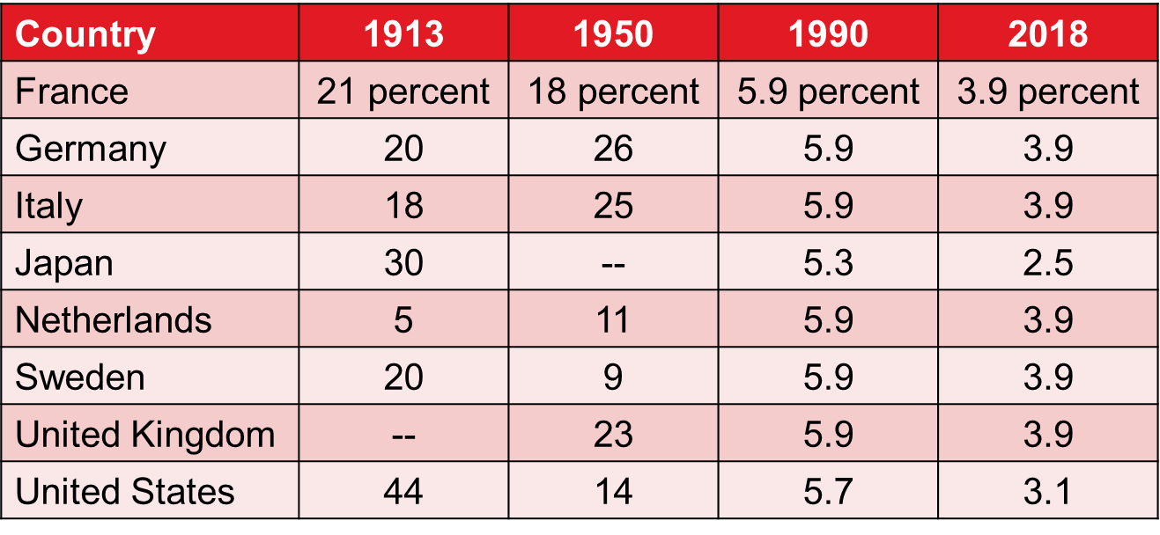
REDUCTION OF TRADE BARRIERS Average Tariff Rates On Manufactured Products
Sources: The 19 13 to 19 90 data are from “Who Wants to Be a Giant?” The Economist: A Survey of the Multinationals, June 24, 1995, pp. 3 to 4. The 2018 data are from the World Tariff Profiles 2019, published by the World Trade Organization.

Slide 17
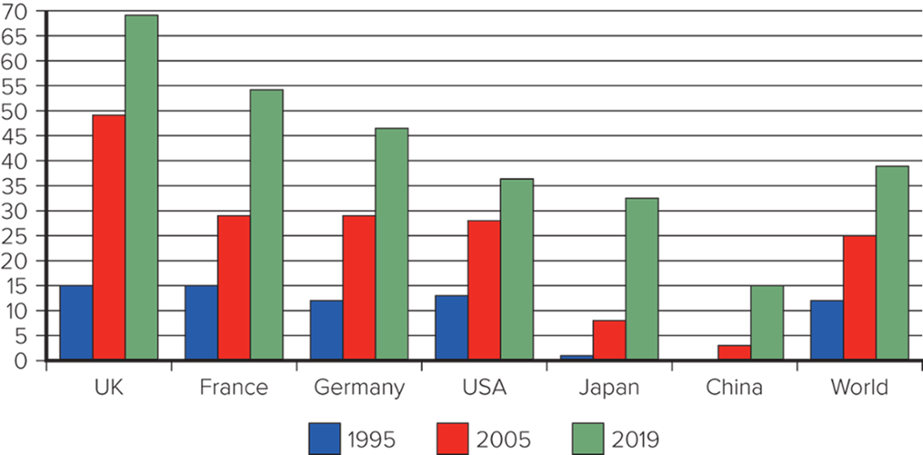
FDI OUTWORD STOCK AS A PERCENTAGE OF GDP
Sources: O E C D data 2020, World Development Indicators 2020, U N C T A D database, 2020

Slide 18
COSTS OF INFORMATION TECHNOLOGY
Cost Trends In Optical Fiber Transmission
Price Trends In Information Processing
Index of transmission cost
per bits per second per kilometer
(log scale)
Index of investment cost
per instruction per second
(log scale)
1,000
45 Mbps
100
IBM mainframe
100
90-135 Mbps
Digital VAX
400 Mbps
10
10
1.2-1.7 Gbps
Cray 1
Bandwidth
1
1
IMB PC
Sun Microsystems 2
2.5 Gbps
0.1
10 Gbps
0.1
40Gbps
0.01
0.01
Pentium
1975
1980
1985
1990
1995
2000
1980
1985
1990
1995
Note: Mbps is megabits per second; Gbps is gigabits per second.
Source: AT&T data
Source: World Bank compilation based on industry data

Slide 19
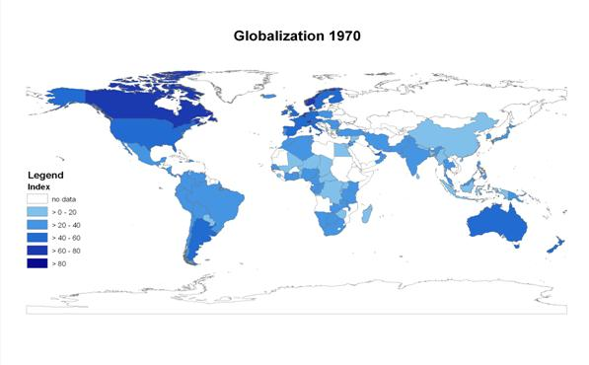
GLOBALIZATION 1970
Source: Axel Dreher, Globalisation and the Labour Market, Department for Business Enterprise and Regulatory Reform, 2007

Slide 20
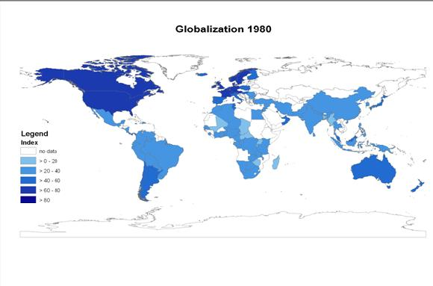
GLOBALIZATION 1980
Source: Axel Dreher, Globalisation and the Labour Market, Department for Business Enterprise and Regulatory Reform, 2007

Slide 21
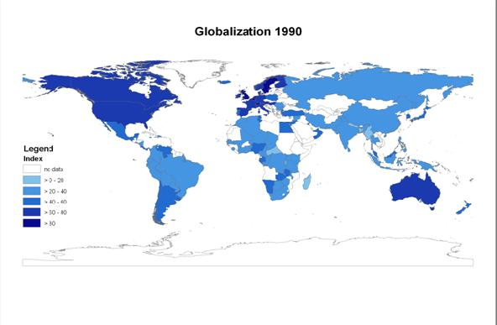
GLOBALIZATION 1990
Source: Axel Dreher, Globalisation and the Labour Market, Department for Business Enterprise and Regulatory Reform, 2007

Slide 22
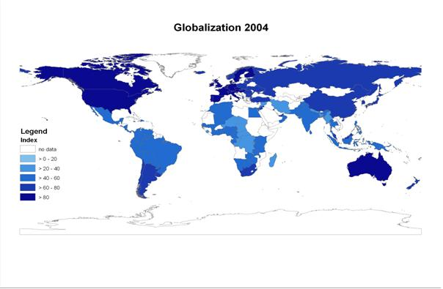
GLOBALIZATION 2004
Source: Axel Dreher, Globalisation and the Labour Market, Department for Business Enterprise and Regulatory Reform, 2007

Slide 23
GLOBALIZATION 2030-40
?

Slide 24
DRIVING FORCES
Firms/MNEs
Environmental
Forces
International
Institutions

Slide 25
DRIVING FORCES (continued)
International Institutions
◆ Eras of Globalization
- 1st Era of Globalization (about 1850 - 1914)
- War & Interwar Period (1915 - 1945)
- 2nd Era of Globalization (1945 – present)
◆ Bretton Woods Agreement (1944) lead by USA
- Fixed exchange rate system
◆ World Bank
◆ IMF(International Monetary Fund)
◆ GATT(General Agreements on Tariffs and Trade)
◆ WTO(World Trade Organization); G8, G20, etc.
Notes:
자유무역(세계화)를 위한 기본 틀을 구축
World Bank : 2차 대전 2년 후에
WTO

Slide 26
DRIVING FORCES (continued)
Environmental Forces
◆ Technological – Internet, WWW, microprocessor,
transportation, telecommunications, etc.
◆ Economic – openness, privatization, economic development
◆ Socio-cultural – similar tastes and preferences
◆ Legal/Political – reducing trade and investment barriers
MNEs(Multinational Enterprises)
◆ Firms go international for markets:
– End-products, Labor, Capital, Law materials, Technology, etc.
◆ Explain 70-80% of globalization
◆ Mostly from advanced nations

Slide 27

THE CHANGING ECONOMIC LANDSCAPE
BRICs vs. G6
When BRIC’s US$ GDP is Expected to Exceed the G6
China
UK
Germany
Japan
US
India
Italy
France
Germany
Japan
Russia
Italy
France
Germany
Brazil
Italy
France
Germany
BRICs
G6
2000
2005
2010
2015
2020
2025
2030
2035
2040
2045
2050
Source – Goldman Sachs

Slide 28
Impact OF
GLOBALIZATION

Slide 29
PROS
Better utilization of resources – greater efficiency through international division of work
Promotes economic development – enlarged pie, Improved quality of life
Promotes innovation – job creation
Free movement of people, goods, and capital
Quick dispersion of technology and ideas

Slide 30
CONS
Uneven distribution of results(enlarged pie) among countries – Income-gap polarization
Concentration of capital and power (MNEs)
- Weaker countries and firms cannot successfully compete
Local economic crises strike the whole world
Quick dispersion of diseases and others
Economic neocolonialism (risk of exploitation) - Human rights, environment, etc.
http://digg.com/political_opinion/Hidden_Face_of_Globalization_2

Slide 31
CONTRIBUTIONS
Most nations gained political independence
Economic improvement:
- GDP/capita: $1800 in 1975, $6400 in 2000
- % of people living below $1/day has halved since 1981
Life expectancy above 60 even for males
Adult literacy near 75% even for females

Slide 32
PROBLEMS
Imbalance of power between leading and following countries - unfair
Exploitative arrangement: leading countries establishing the rules and others expected to follow
Balance of power: tilted from labor to corporate management
Wealth: skewed in favor of a few countries in the world

Slide 33
BALANCING PROS AND CONS FOR SUSTAINABILITY
Economic growth
CSR Green
Efficiency
Economic development
Income Polarization
Human Rights Issues
Environmental Issues
Globalization

Slide 34
IMPLICATIONS and CONCLUSIONS

Slide 35
GENERAL IMPLICATIONS
Globalization has both positive and negative sides, but it has net
gains.
We need to expand the positive side while addressing the negative
side of globalization.
Any country with economic power is likely to push the idea of
globalization.
The leading countries are likely to gain from globalization more
than the following countries.
Globalization is a general trend.

Slide 36
IMPLICATIONS FOR OUR GOVERNMENT
● Pursue globalization to the extent possible.
● But remember that there are winners and losers of globalization in our society as the structure of our industries changes.
● Pay attention to the losers; prepare a safety net for the losers.
● Deal with uneven income distribution – income polarization.
● Follow global standard in terms of laws and ethics – corruption.
● Build the infrastructure amenable to globalization – language, schools, other systems

Slide 37
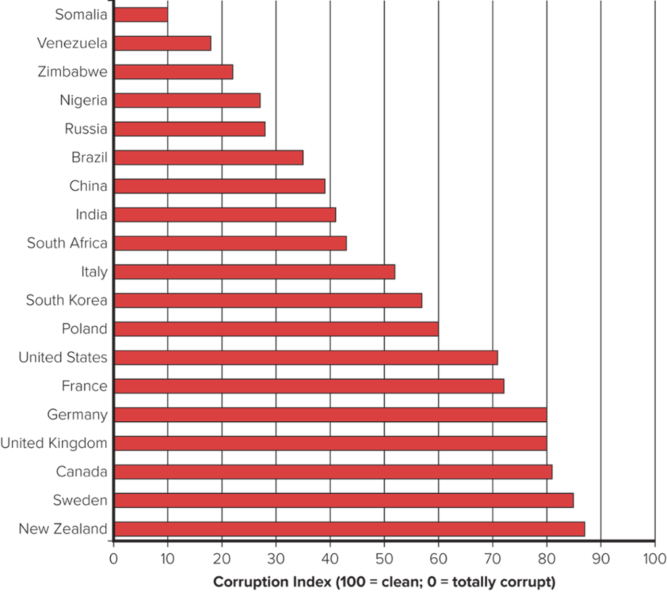
Rankings of Corruption by Country in 2019
Sources: Transparency International, “Global Corruption Report, 2019”

Slide 38
IMPLICATIONS FOR OUR BUSINESSES
● Have a global perspective in business management
● Tap the most optimal locations for activities and resources
● Exploit economies of global scale, scope, and learning
● Adapt to local market differences
● Create global competitive advantage
● Pay attention to corporate social responsibilities and green issues

Slide 39
IMPLICATIONS FOR US INDIVIDUALS
Have a global perspective on issues
Be a sound global citizen:
- with a global ethical standard
- with global language fluency
- with open mind
Make yourself more competitive in a global job market
- Remember that ‘the winner takes it all’ in a globalized world.
- Remember that your competitors are not geographically
bounded.
Value/respect domestic cultures as well as foreign cultures.

Slide 40
CONCLUSIONS
Globalization is a positive sum game. It increases the pie, but
the issue is who gets what.
The government, companies, and individuals need to take
advantage of globalization and address the problems(e.g.,
unfairness, human rights, environment, etc) of globalization to
sustain it.
Globalization provides both opportunities and threats to the
government, companies, and individuals.
If globalization is something we cannot avoid, we’d better enjoy
it.
Notes:
슘페터 경제 모형
세계화가 가지는 긍정적, 부정적 영향들
세계화는 글로벌 흐름이고 맞춰나가야 함.

